Slide 1

The following analysis breaks down the performance of Hedge Funds around the world
The aim is to visualize the data so as to get a better and more accurate picture of what the data represents
We are able to compare Strategy against financial performance, and able to see top performing firms

Slide 2
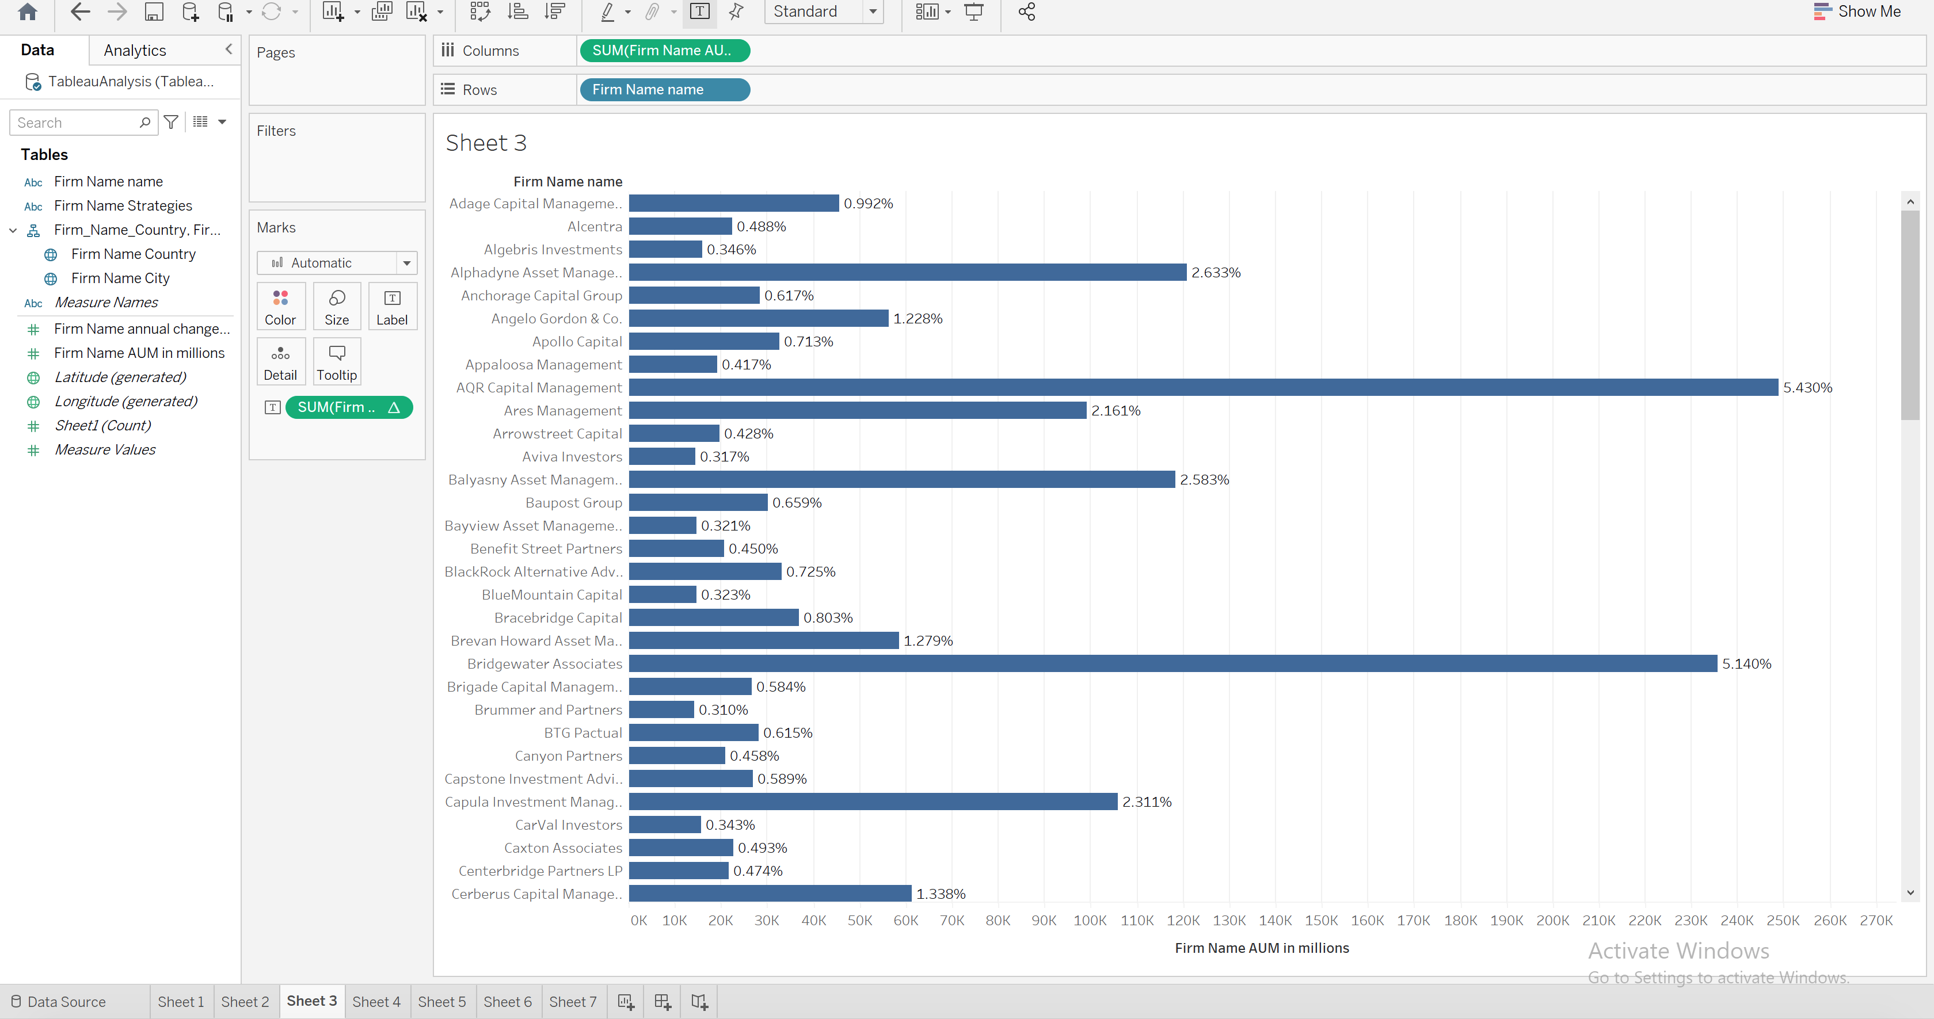
Comparing the Firm against the value of its Assets Under Management in millions and as a percentage

Slide 3
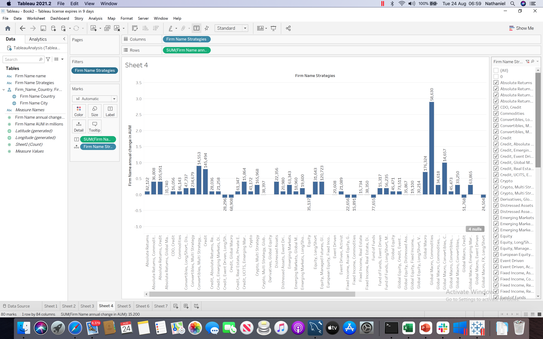
Comparing the firm's strategy against the value of its portfolio

Slide 4
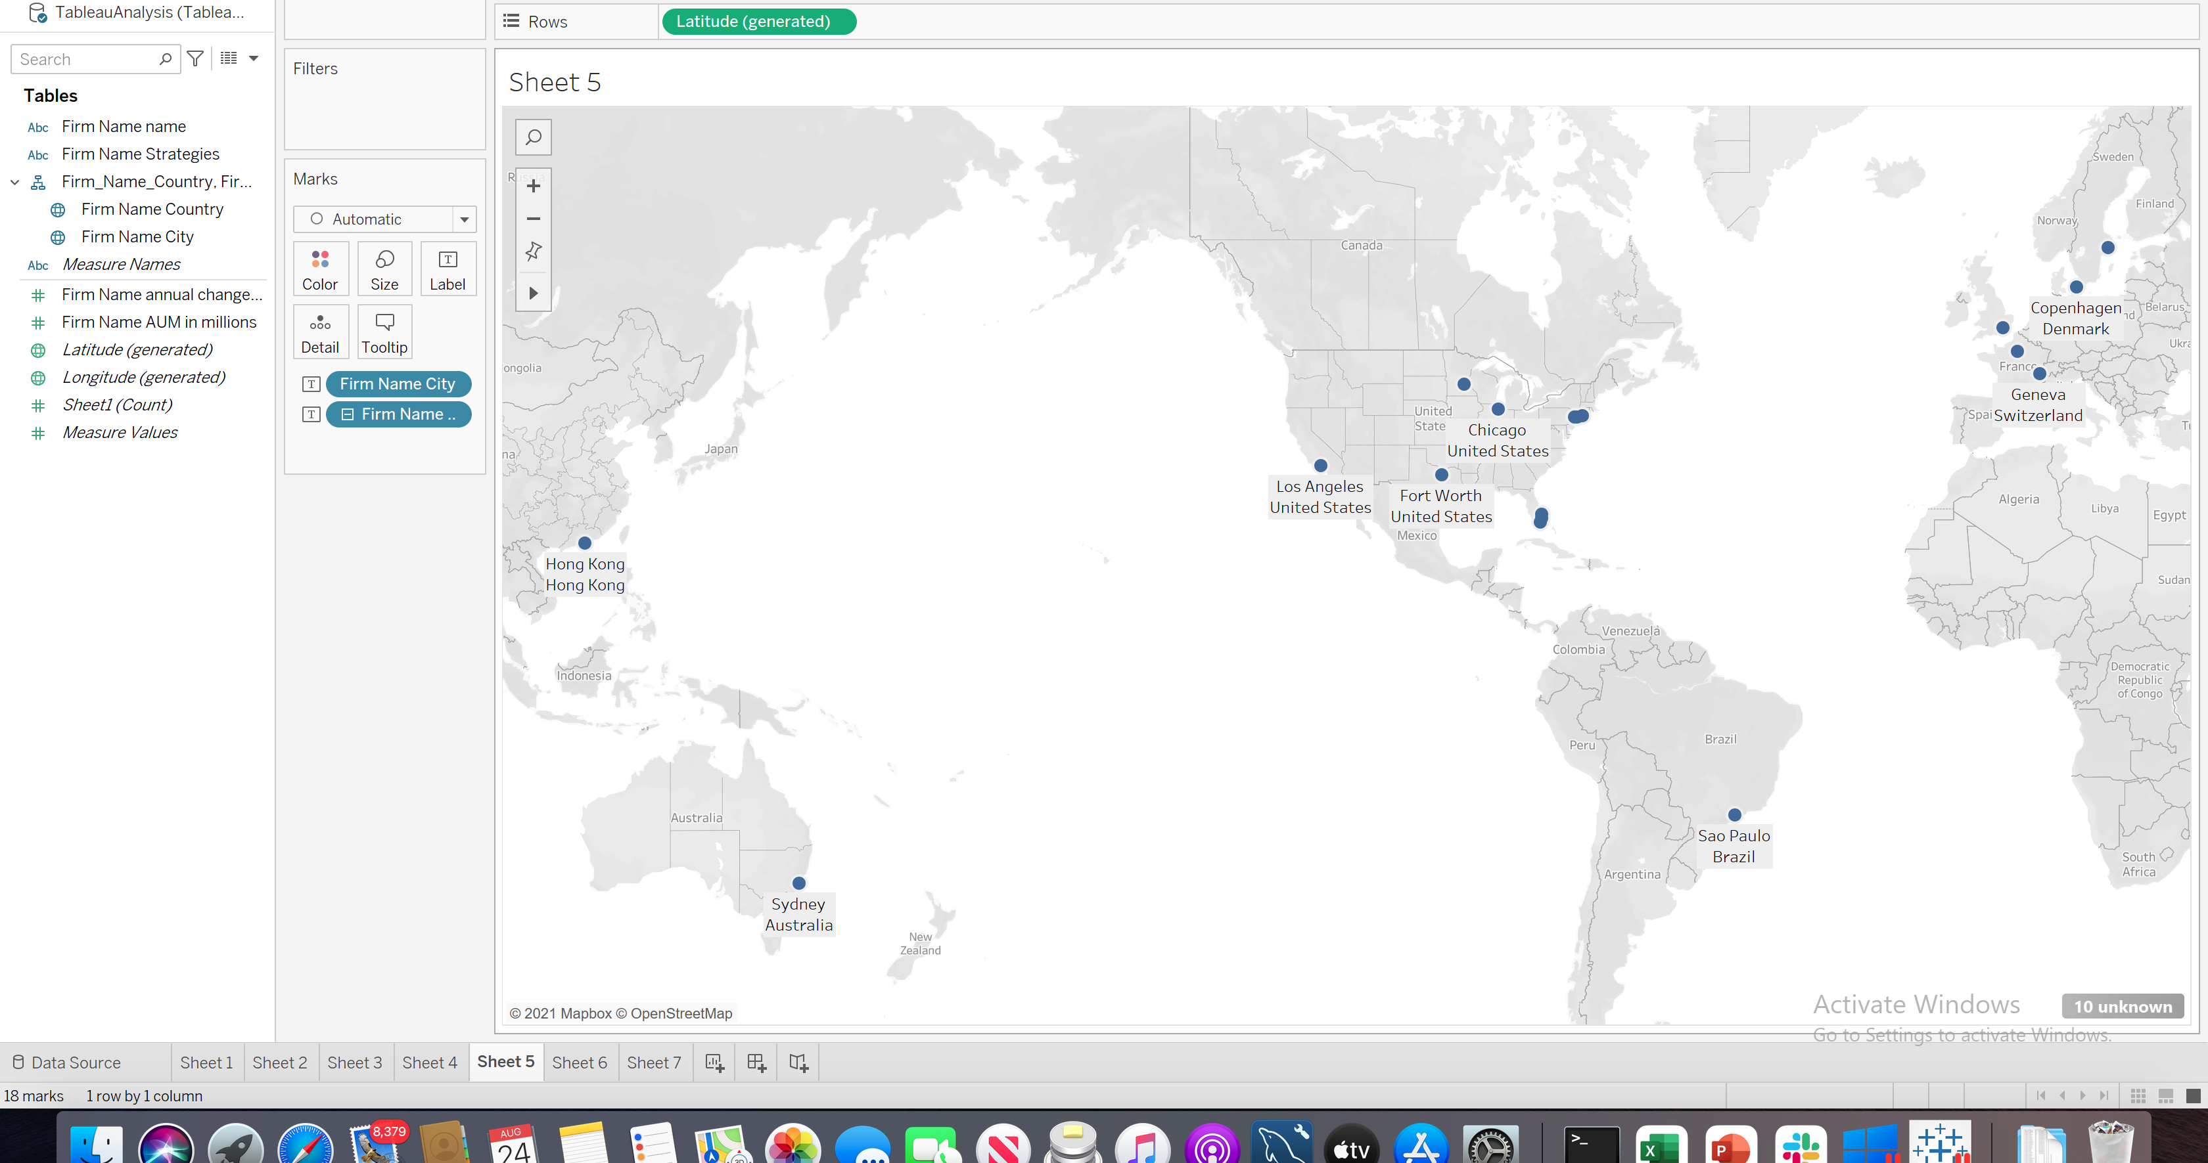
Firm locations by country and city

Slide 5
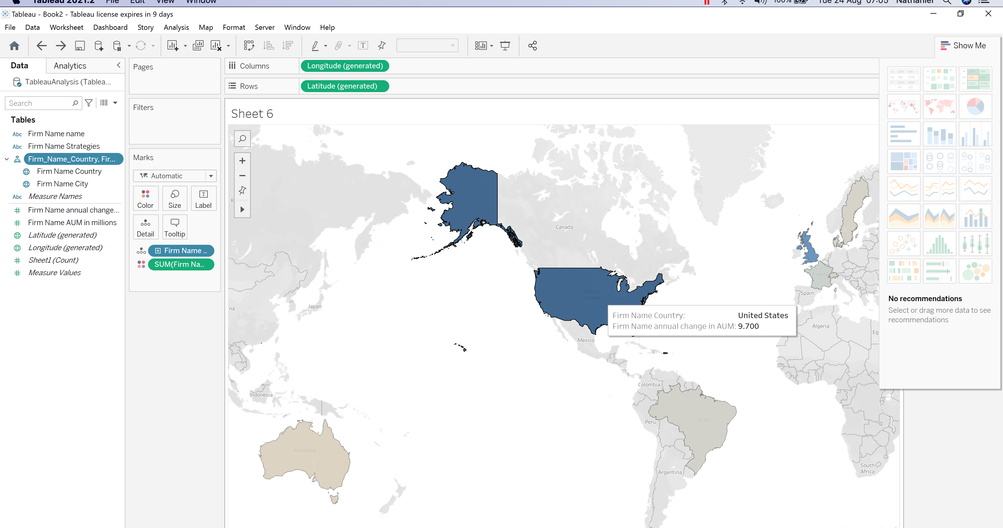
Total of Assets Under Management by region

